Slide 1

Streaming Music Popularity Prediction
Team One
DSGA-1007

Slide 2
Table of contents
01
02
03
04
Problem Statement &
Dataset
Data Preprocessing & EDA
Feature Engineering
Model

Slide 3

01
Problem Statement
& Dataset

Slide 4
Problem Statement
The primary objective of this project is to enable record companies to make data-driven investment decisions in new music releases.
We will look into the inherent features of songs to develop a predictive model for measuring their potential popularity.
Record companies can make strategic business decisions, investing in songs that can bring maximum returns to the company as the result of high popularity.

Slide 5
Dataset: Spotify Songs
The chosen dataset provides 32833 songs released from 1957 to 2020 that have been collected by Spotify. There are 23 columns, representing 23 features each song possesses.
track_id | track_name | track_artist | track_popularity | track_album_id | track_album_name | track_album_release_date | playlist_name | playlist_id | playlist_genre | play_list_subgenre | danceability | …
a1r | Memories | Maroon 5 | 67 | c22 | Memories | 2019-12-13 | pop Remix | 11c | pop | dance pop | 0.675
energy | key | loudness | mode | speechiness | acousticness | instrumentalness | liveness | valence | tempo | duration_ms
0.577 | 1 | -4.969 | 1 | 0.037 | 0.072 | 0.0042 | 0.357 | 0.693 | 99.97 | 162600

Slide 6
02
Data Preprocessing
& EDA

Slide 7
1st Round Data Processing
Remove Irrelevant Features
Data Transformation
Missing Value Imputation
Features like track name and track artist are removed; those are not general features can be applied to the model
Derive month and year from release date, and add new feature “decade”
Replace the missing value in month with 0 for computation convenience

Slide 8
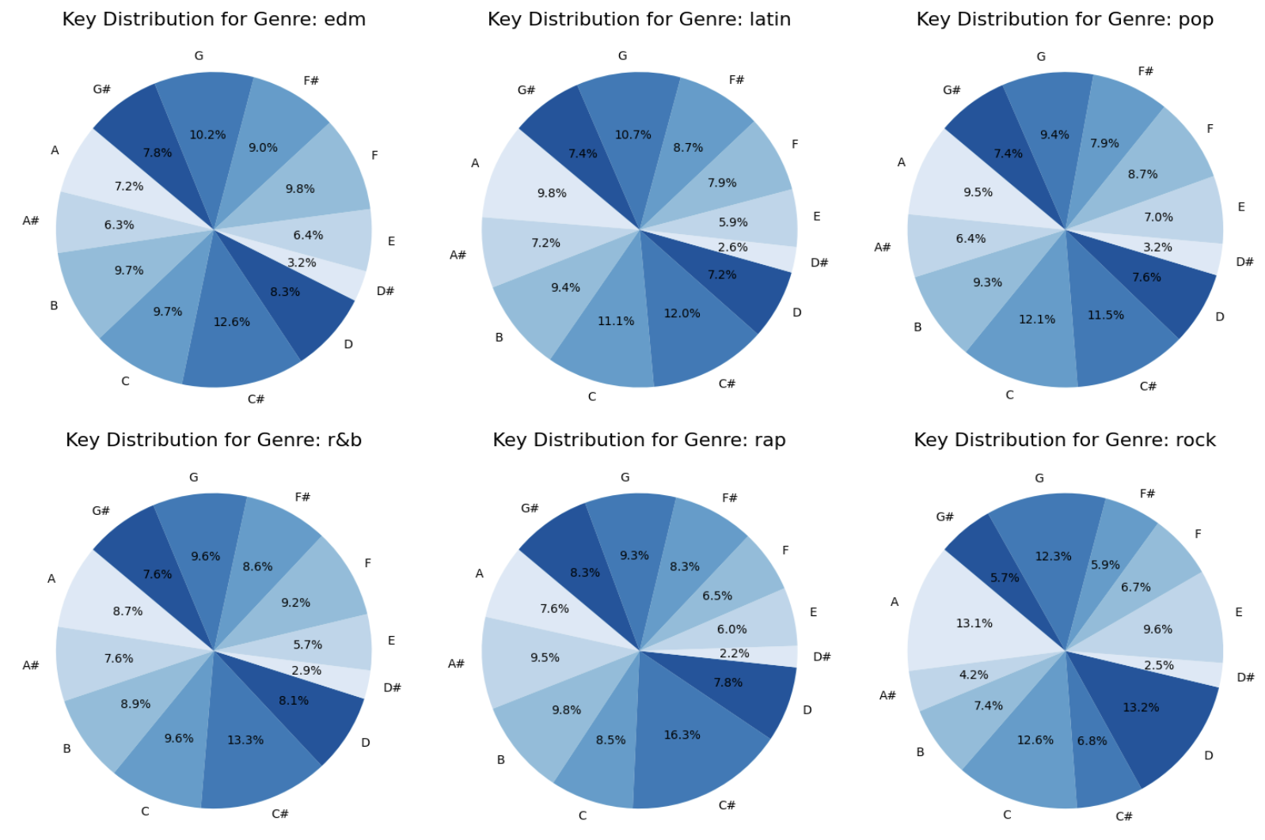
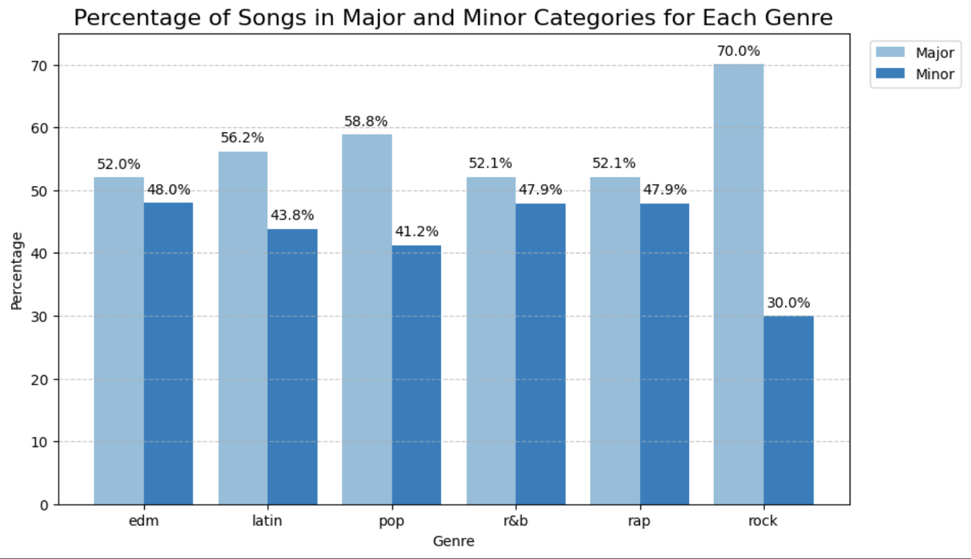
Time-Irrelevant Feature Exploratory
Major occupies a large portion for all six genre
C# is the dominant key
Notes:
.drop(['track_album_release_date','playlist_name','decade','mode_name','key_signature']

Slide 9
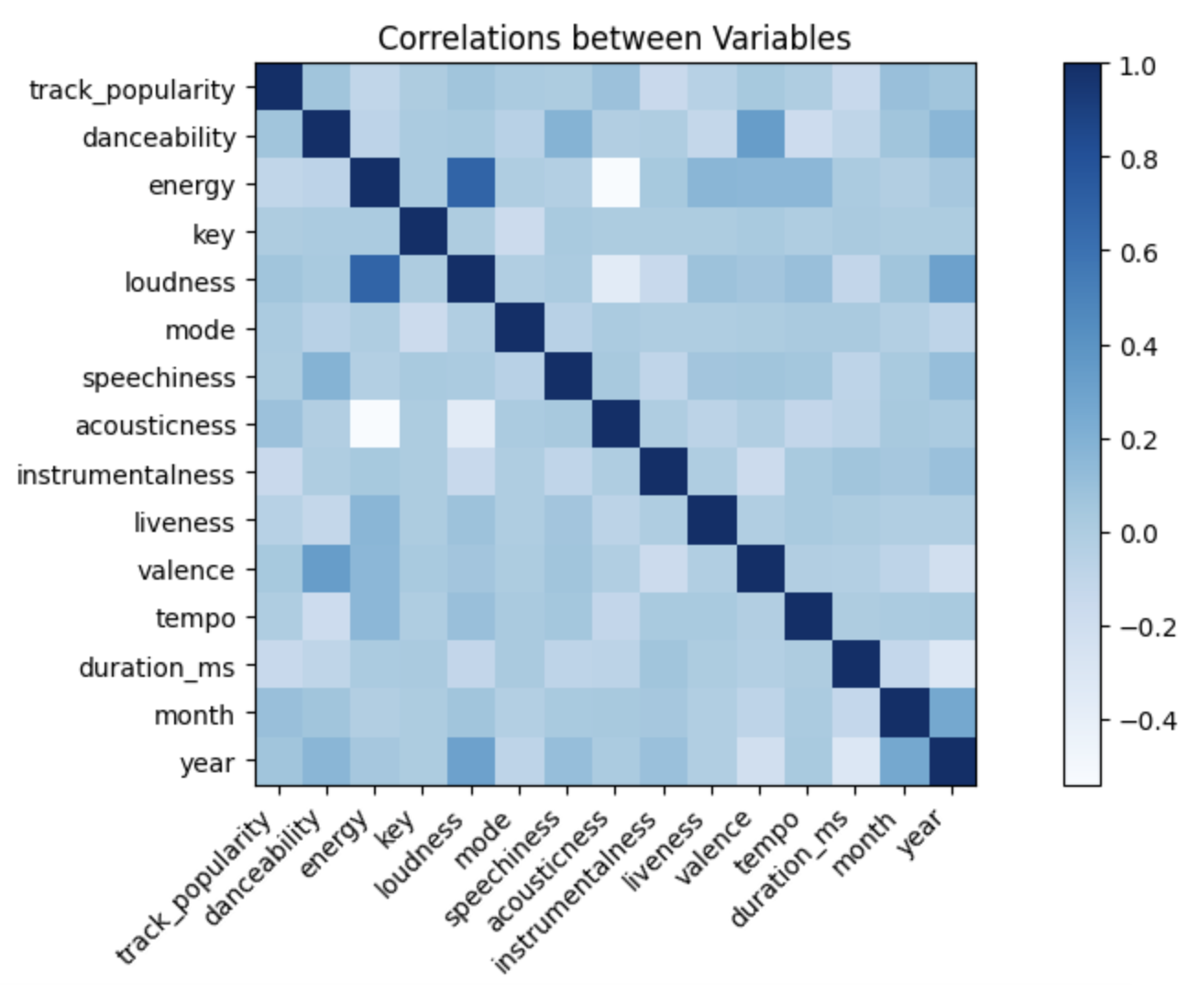
Time-Irrelevant Feature Exploratory
Notes:
.drop(['track_album_release_date','playlist_name','decade','mode_name','key_signature']

Slide 10
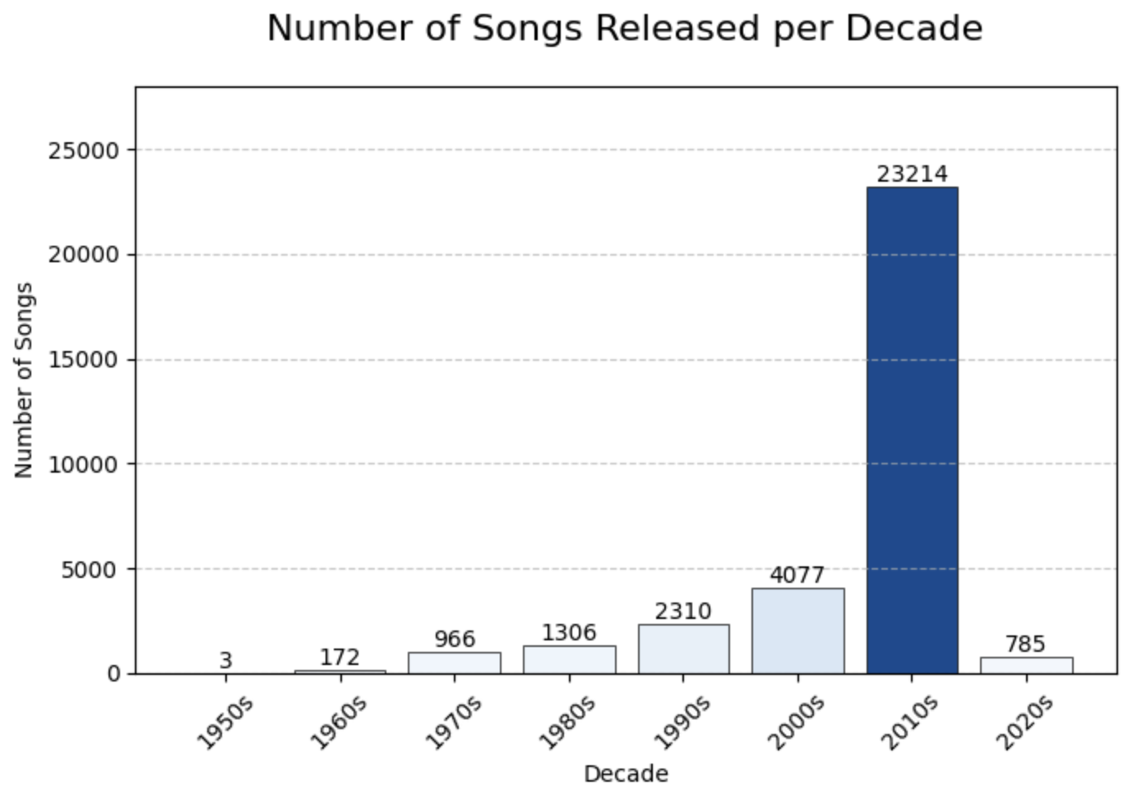
Distribution with Respect to Time
2010s are the dominant one!
Notes:
.drop(['track_album_release_date','playlist_name','decade','mode_name','key_signature']

Slide 11
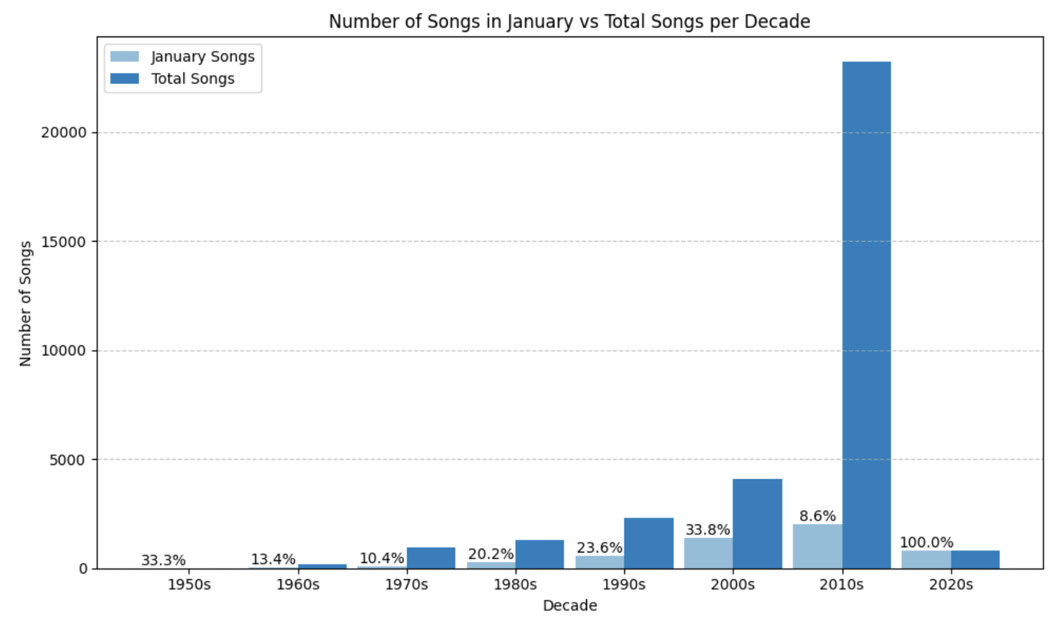
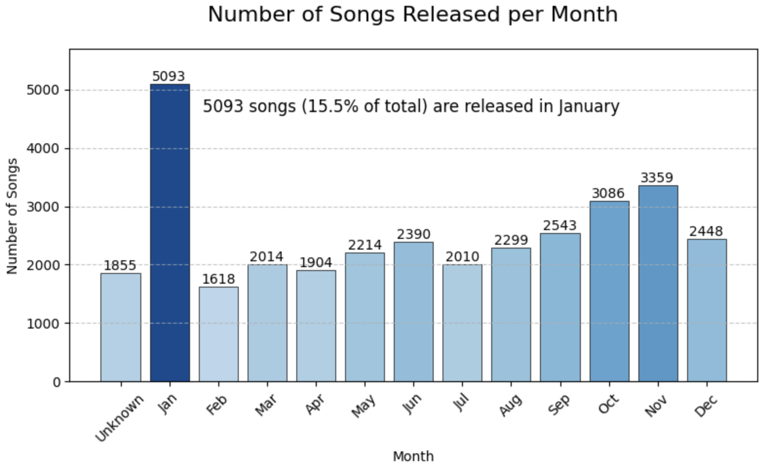
Distribution with Respect to Time
Abnormal percentage lies in January
Notes:
.drop(['track_album_release_date','playlist_name','decade','mode_name','key_signature']

Slide 12
Why?
Data Collection
Data Cleaning
The data is collected in January 2020, leading to one extra month of data in only one category.
Songs with no month information is directly marked as being published on Jan 1st in the original data set.

Slide 13
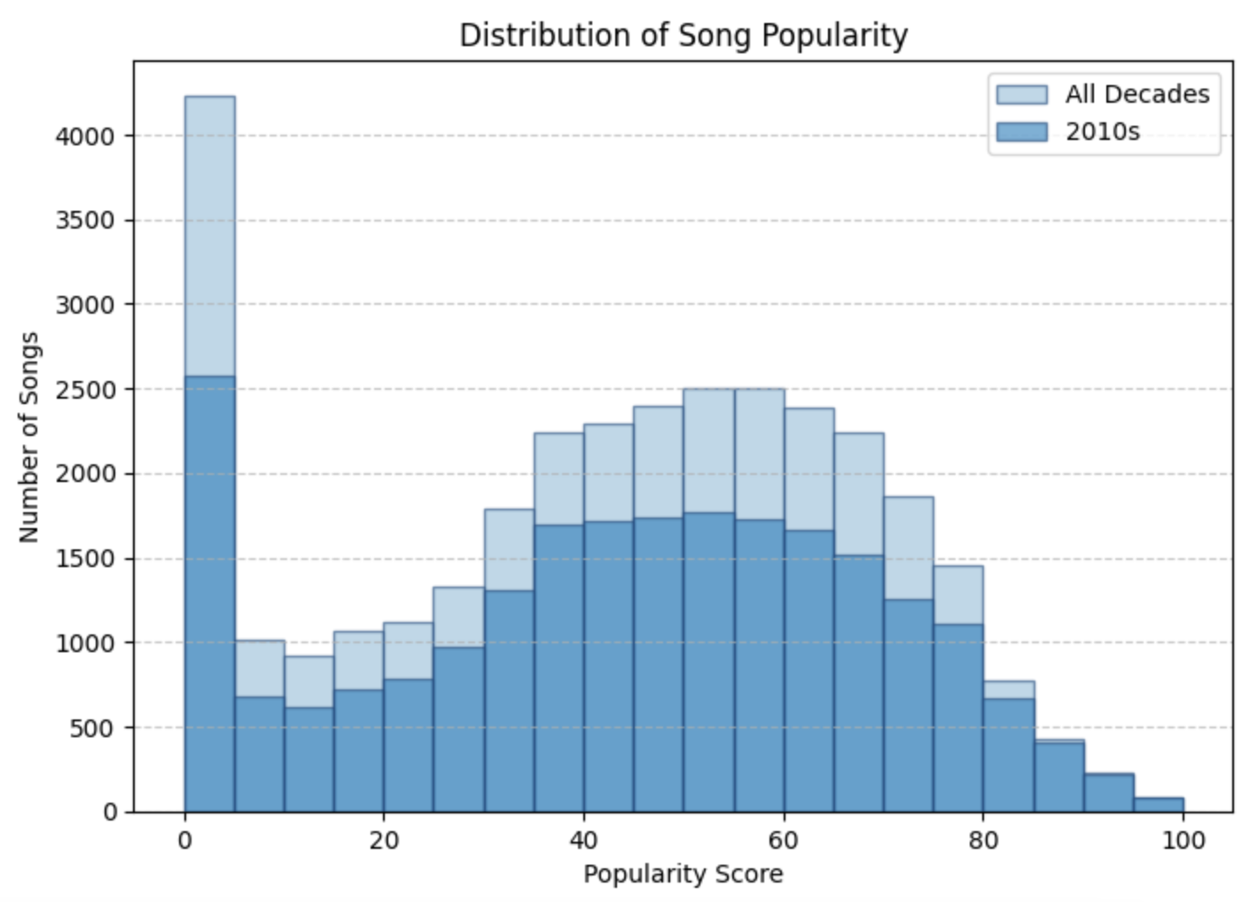
Distribution with Respect to Popularity
A high peak in zero is also valid data.
Notes:
.drop(['track_album_release_date','playlist_name','decade','mode_name','key_signature']

Slide 14
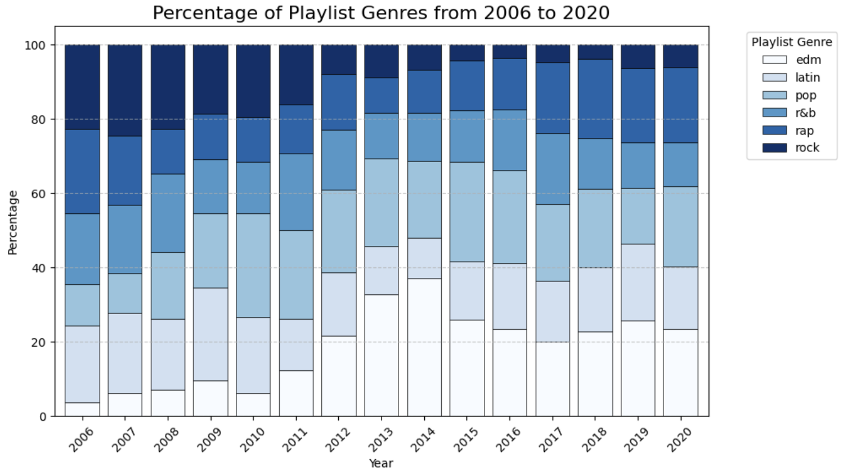
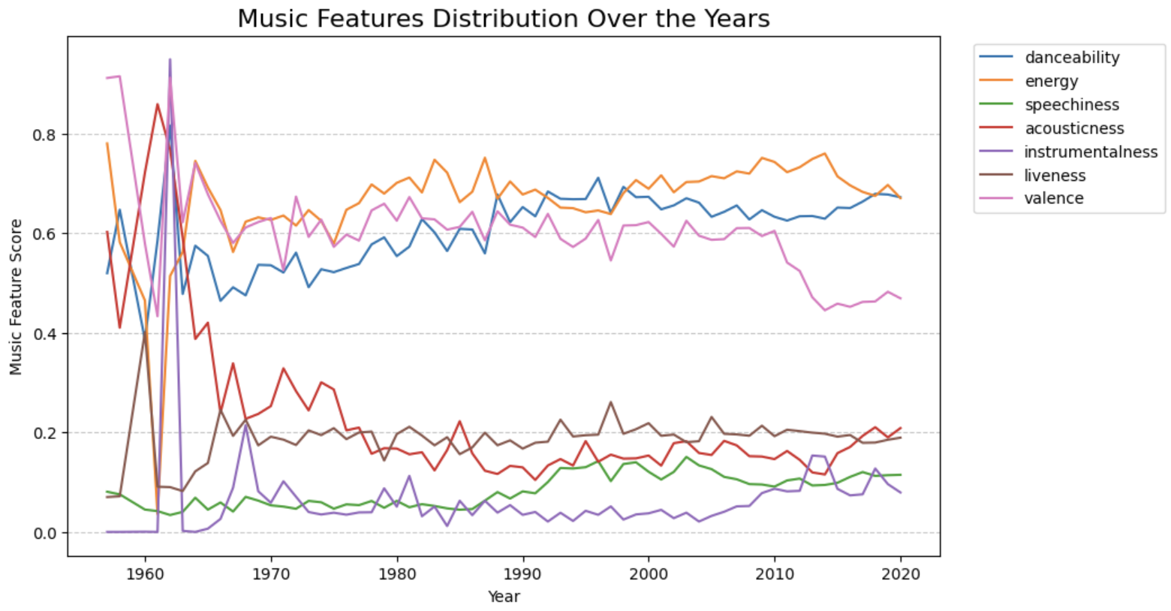
Trend over Time
Notes:
.drop(['track_album_release_date','playlist_name','decade','mode_name','key_signature']

Slide 15
2nd Round Data Processing
Remove Misleading Information
Normalize Score
Vague publish dates and issues in data collection caused mis-assigning songs to January category.
Exclude time factor in calculation of popularity score.

Slide 16
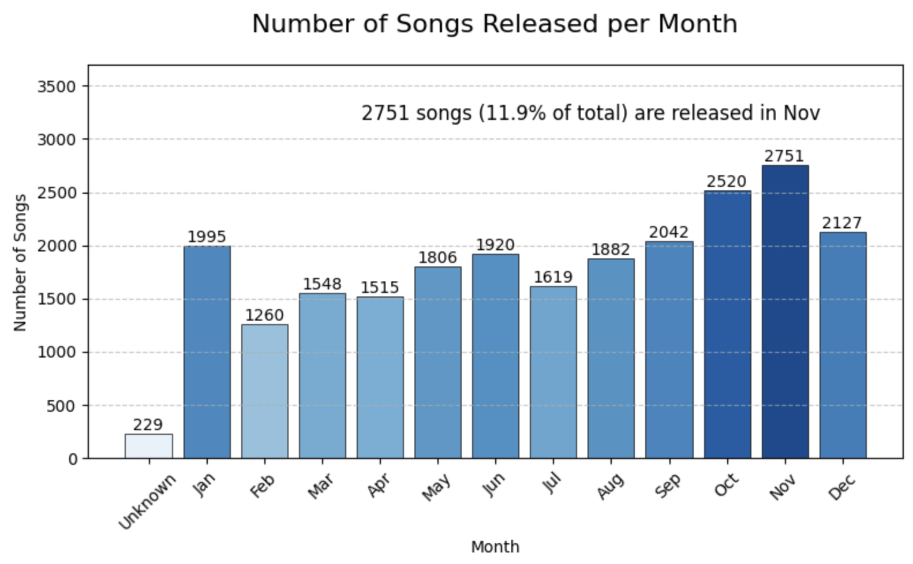
Updated Distribution with Respect to Time
Data after second round cleaning is better for our prediction model!
Notes:
.drop(['track_album_release_date','playlist_name','decade','mode_name','key_signature']

Slide 17
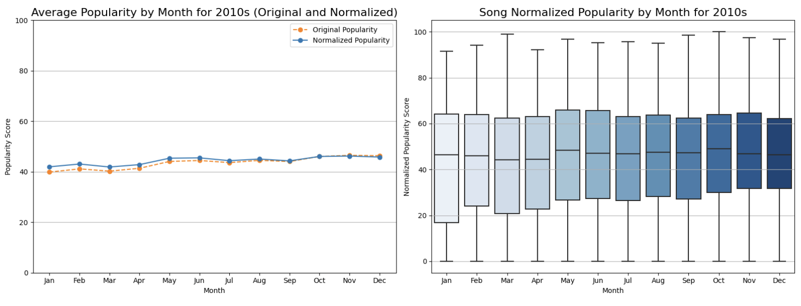
Normalized Score
Data after second round cleaning is better for our prediction model!
Notes:
.drop(['track_album_release_date','playlist_name','decade','mode_name','key_signature']

Slide 18
03
Feature Engineering

Slide 19
Data Preparation
Dealing with Categorical Features
Data Selection: gener(6) & subgener(24)
One-hot Encoding
Concat with numerical data
Dealing with Target Variable (track popularity score)
Most of the popularity score is 0, we decided to change the regression model into binary classification
If the track popularity score is above median, mark it as popular(popular = 1), otherwise mark it as unpopular(popular = 0)
Notes:
.drop(['track_album_release_date','playlist_name','decade','mode_name','key_signature']

Slide 20
Feature Selection
Since our dataset is a high-dimensional data(44 features), we decided to perform feature selection to choose important features for our model building.
Random Forest
Chi-Square Test

Slide 21
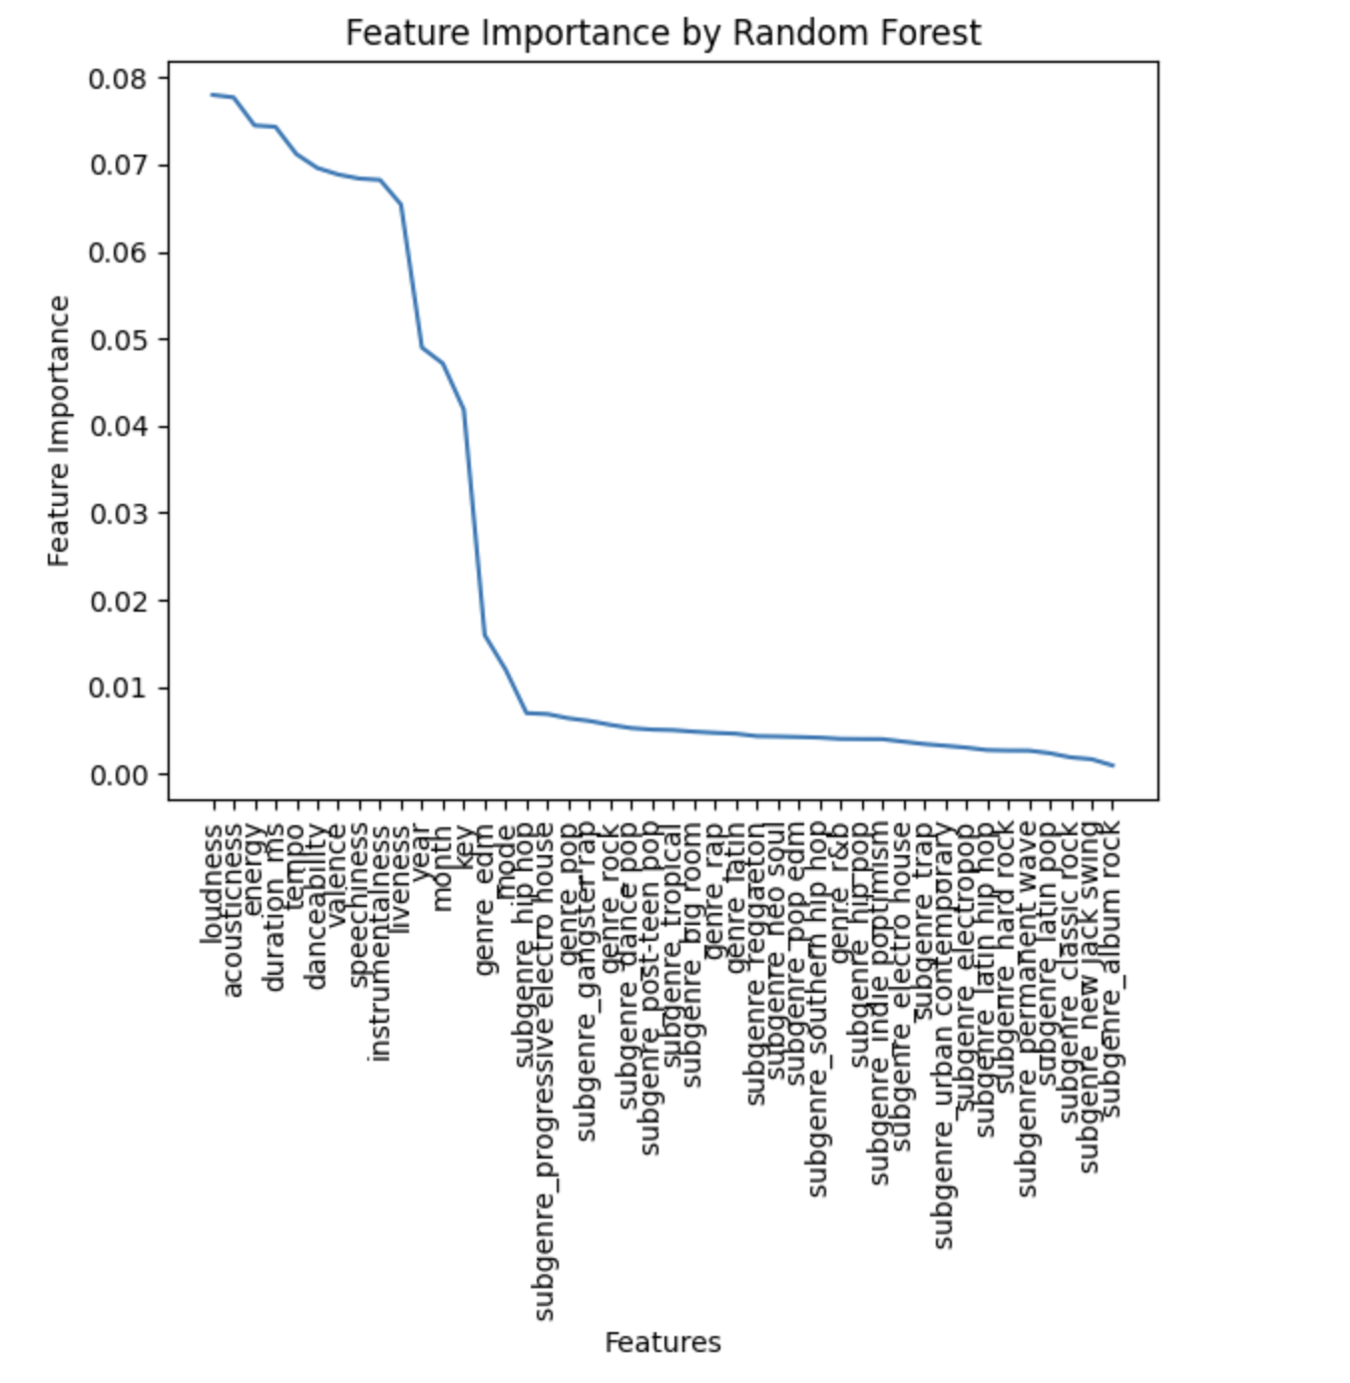
Feature Selection
Random Forest
Based on Gini Impurity
Selected 13 Features:
loudness, acousticness, energy, duration_ms, tempo, danceability, valence, speechiness, instrumentalness, liveness, year, month, key
All of the selected features are numerical features!!!
Random Forest is sensitive to one-hot encoding
Notes:
Gini impurity tells us how much a feature contributes to reducing the uncertainty or "impurity" in the classification of data points in a decision tree, and it is calculated by assessing how well the feature separates different classes in the data. Higher Gini importance indicates a more influential feature in the model.
Why is RF sensitive to one-hot encoding?

Slide 22
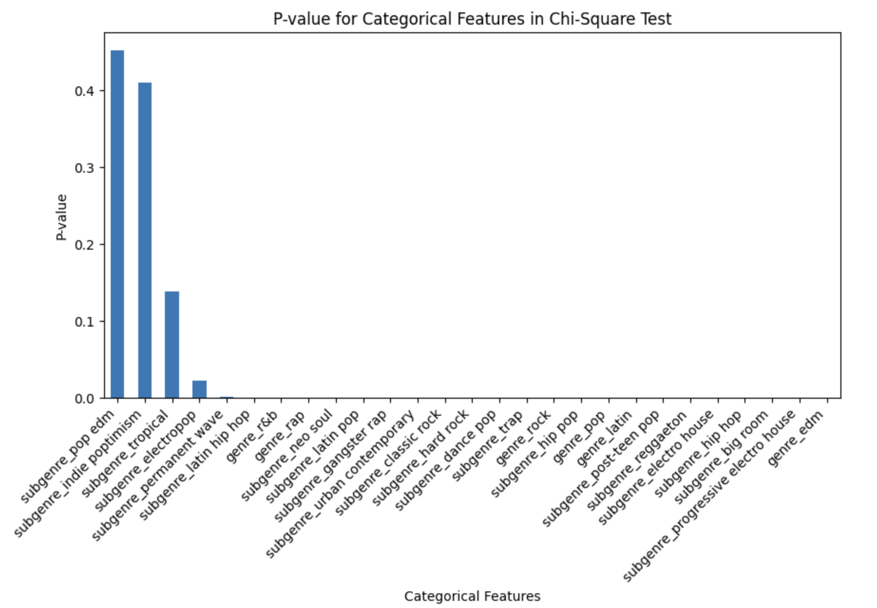
Feature Selection
Chi-Square Test
Test if each categorical feature is independent of the target variable (popular)
H0: There is no significant association between the categorical feature and the target variable (popular)
H1: There is a significant association between the categorical feature and the target variable (popular)
Too many significant categorical features!

Slide 23
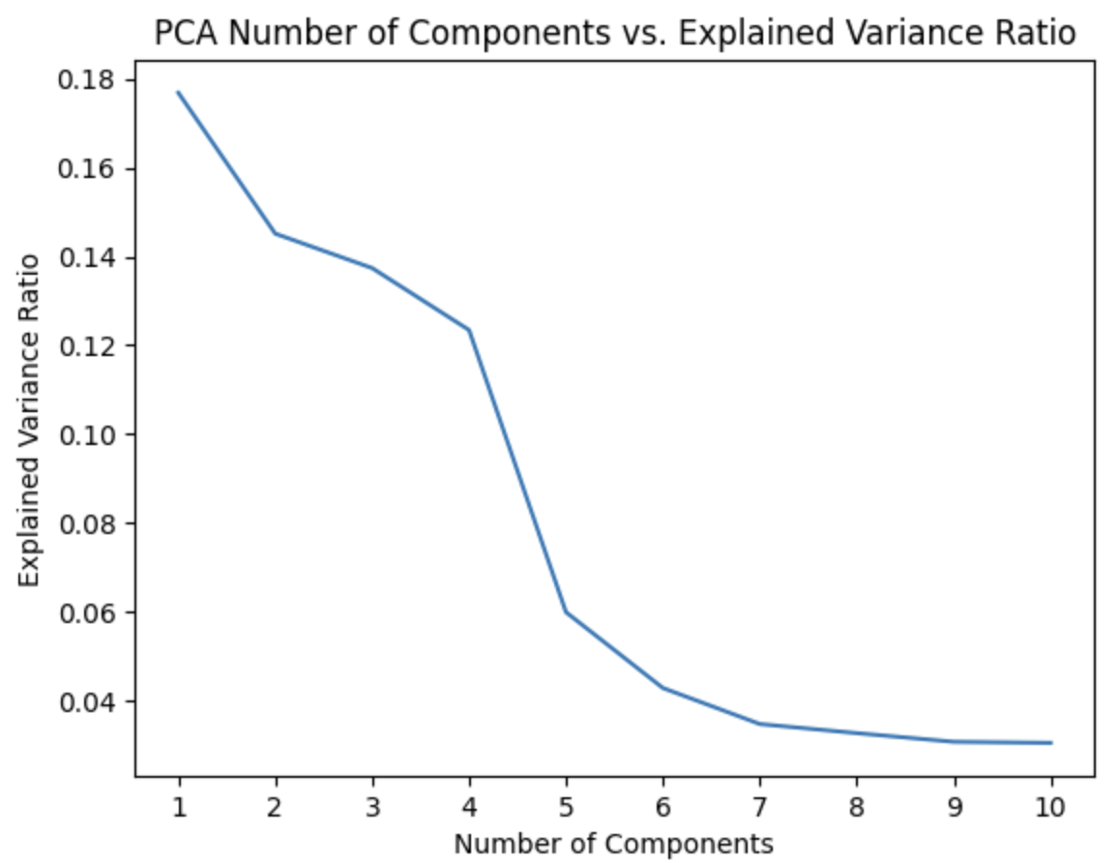
Feature Extraction
Principal Component Analysis(PCA)
Choose principal components from the selected categorical features in Chi-Square distribution
Choose first 4 principal components
Notes:
PCA 原理

Slide 24

04
Model
Notes:
Thank ruxi for her introduction, now let me take over to introduce the model we built

Slide 25
Model Selection
 | Random Forest | XGBoost | Logistic Regression | Neural Network
Interpretable
Small Data Volume
Probability Prediction
Computational Efficiency
Robust
Notes:
The first step is to select a model that better fit our data. We have five candidates models. We consider this problem from 5 perspectives. Firstly, interpretability, as this model is used for business decision, we need its performance to be interpretable to better communicate with management and shareholders. NN may not be suitable in this scenario as they are usually hard to interpret. Secondly, as the data only contains around 30k entries, it is relatively small volume. We need to choose model that caters small data. Thirdly, probability prediction, as the business model do not require us to give a binary answer of whether a song would be popular, we are more interested in how likely a song would be popular given features. XGBoost and Logistic Regression are better for this probability prediction. Lastly, robust performance. Logistic regression failed to converge in some scenarios we would not choose it for this. Finally, considering all these aspects, we decide to use XGBoost as our baseline model

Slide 26
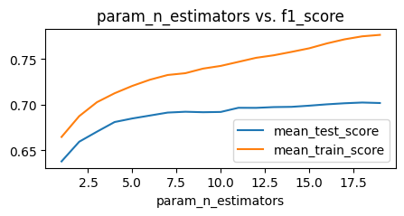
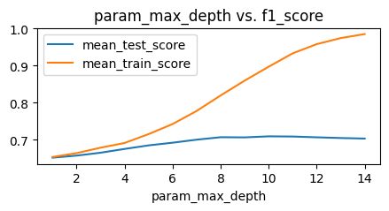
Key Parameters Influence Performance
n estimators
max depth
Notes:
As the data volume is relatively small, and the number of relevant features is small, we need to pay very close attention to overfitting problem.
Main parameters we tuned to mitigate overfitting including n_estimators, max_depth, min_child_weight and learning rate
N_estimators refers to the number of weak learners we are going to use in the model training, we found that for an n_estimator over 10, the model starts to overfit, therefor, we keep the optimal n_estimator at 10
Max_depth controls how deep each weak learner need to grow, from the learning curve, depth over 4 has already lead to overfit, we keep this depth at 4.

Slide 27
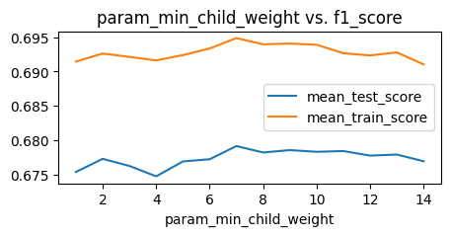
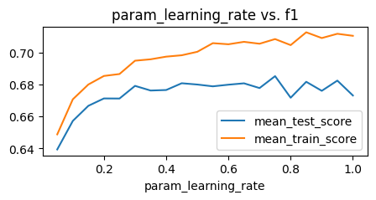
Key Parameters Influence Performance
min_child_weight
learning_rate
Notes:
For min_child_weight, the larger, the model become more conservative, we set it at 7 when there is a slight boost in performance.
For learning rate over 0.4, it does not improve either training or validation performance

Slide 28
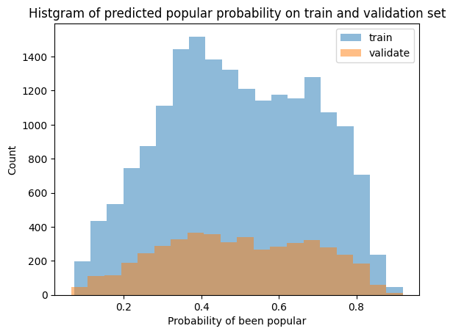
Training and Validation
 | F1 | Precision | Recall
Train | 0.6927 | 0.7045 | 0.6813
Val | 0.6739 | 0.6834 | 0.6646
Notes:
As a result, we have our training performance with f1 score at around 0.7, and validation performance at around 0.67

Slide 29
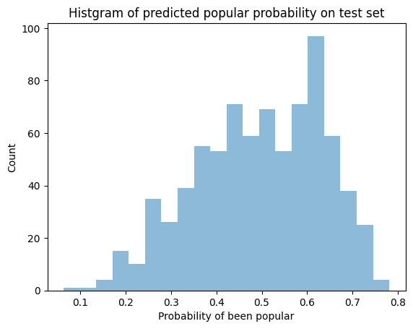
Testing on 2020s
 | F1 | Precision | Recall
Test | 0.5618 | 0.5436 | 0.5813
Notes:
However, the test performance for future data is not as ideal as training set.

Slide 30
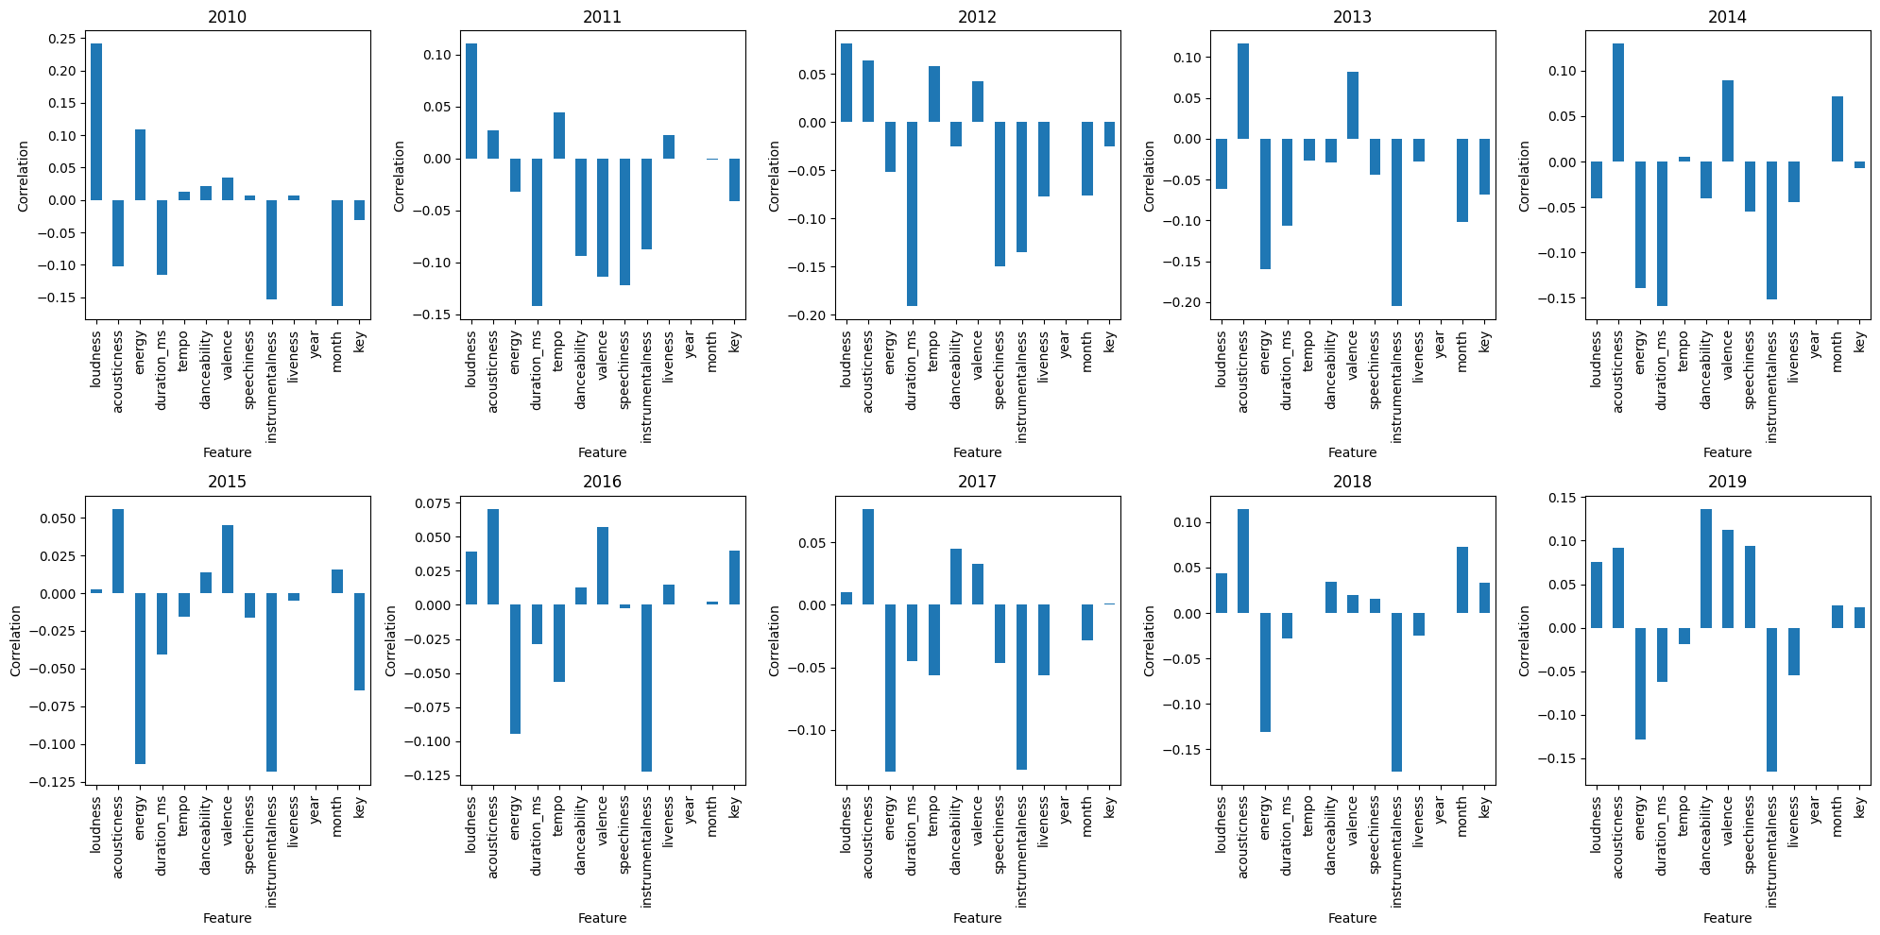
Limitations
We can see that that the model cannot generalize to future data. One of the possible reasons can be that people’s music taste varies over time, and such variation maybe random and unexpected.
Notes:
This failure in temporal generalization may be due to the random change in music taste. From the plot, we can see that the correlation between each feature and the popularity varies a lot over time. For example, loudness sometimes positively correlates with popularity, but in some year it negatively affects popularity. Other features like energy and valence show similar behaviors. Therefore, to better predict near future, data on the most recent period would be more important. For future work, we may try collecting more data in recent years. Also, time series analysis may help as grasp a better understanding of how music taste varies over time, and model the most likely taste in the future.

Slide 31
Q&A

